Slide 1
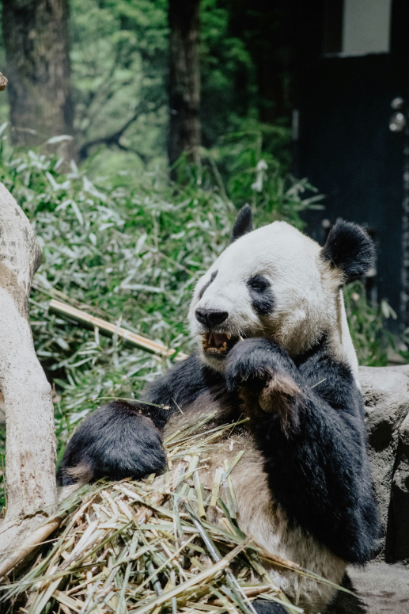

Pandas Optimization
Understanding Pandas Optimization
- Pranali Bose

Slide 2

01
01
Why Optimization
02
Best Practices
Best Practice
Agenda
03
Advanced Techniques
04
Use Case
Use Case
05
05
Q/A

Slide 3
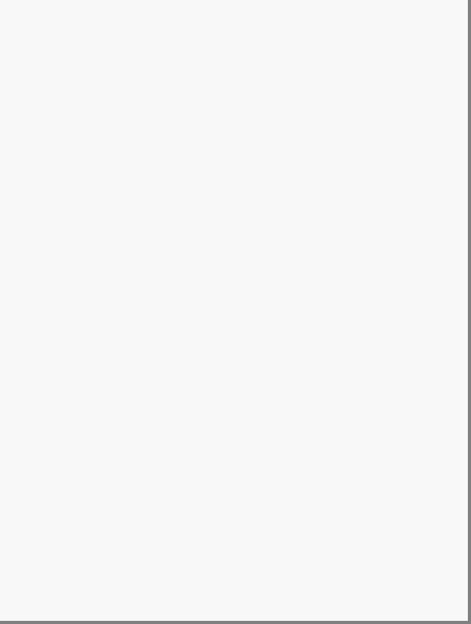
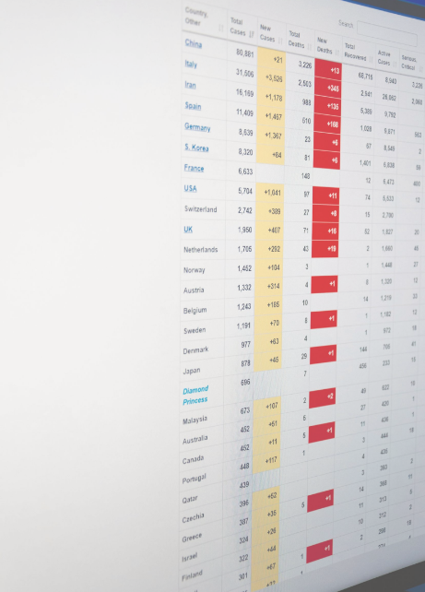
Why Optimize?
Performance
Memory Usage
Scalability
Speed
Resource Management
Batch Processing
Productivity
Complex Operations
Real-Time Analysis

Slide 4

Best Practices
Downcast datatypes
Faster lookups
Avoid creating copy
Filter before merge/join/concat

Slide 5
Advanced Techniques
Chunking
Indexing
Vectorized operation
Memory Profiling

Slide 6
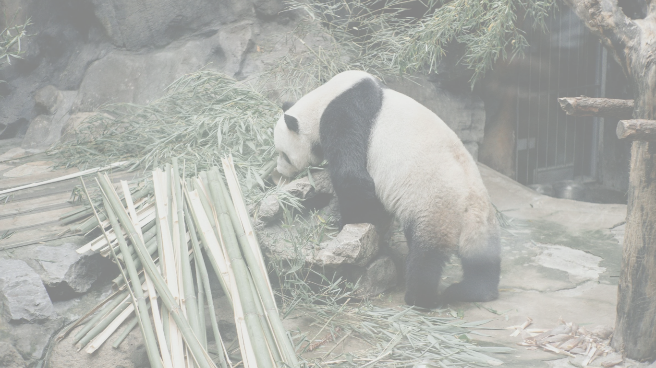

USE CASE
Reading large CSV file using chunking

Slide 7


Any questions?
Webinar Presentation

